Slide 1

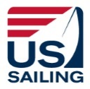
LSYC Race Committee
_____ 101 _____
_________________________
An Introduction to Sailboat Racing
and LSYC Race Committee Volunteering
Content largely from : US SAILING RACE MANAGEMENT COMMITTEE – MARCH 2017
edited by Jane Wirch May 2025

Slide 2
One Design Racing
One design Boats are boats that are built to the same exact specifications (dimensions, sail area and other key features).
Examples (boats one might see on Lake Sunapee)
  Dinghies (have centerboards) such as 420s, Flying Scots, Optimists
  Keel boats such as Sonar, Stars, Vipers
One Design Racing is sailboat racing where all the boats are identical and so the emphasis is on teamwork, skill, and strategy.
Whoever crosses the finish line first wins!

Slide 3
Handicap Racing
Handicap Racing is racing that allows different boat designs to race against each other by adjusting the finish times by a mathematical formula.
Lake Sunapee Cruising Fleet offers regular handicap racing.
LSYC offers both one design racing
and handicap racing

Slide 4










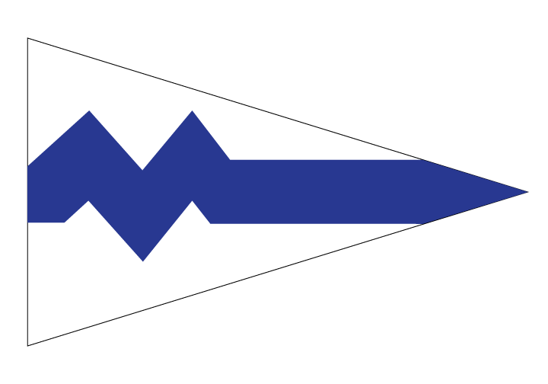


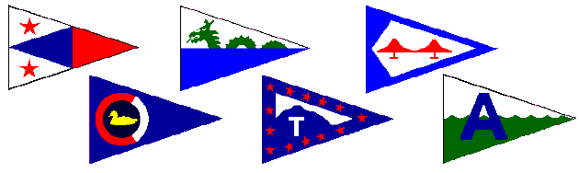



Who Makes the racing rules?
World Sailing
The United States Sailing Association
Local Sailing Organizations
One Class Design Associations
(there are about 160 associations)

Slide 5
Rules of the Game: a framework for fairness
World Sailing Racing Rules of Sailing (RRS)
  US Sailing Prescriptions (to the RRS)
  World Sailing Cases and US Sailing Appeals (“case law”)
  Class Rules - equipment
Notice of Race (NOR) – A posting of “Hey! We’re having a regatta!” . Yacht Scoring is a commonly used website but there are others.
Sailing Instructions (SI) – explains the intentions of the RC and competitors’ obligations
LSYC writes NOR and SI for events we host!

Slide 6
The Race Committee
The Working Race Committee for a day may include:
  Signal Boat – usually anchored at the start line
  Mark Boats – used to set marks
  Safety Boats – roving boat(s) assisting sailors

Slide 7
The Signal Boat anchored at start line
There are 6 important jobs:
The Principal Race Officer – “The Conductor”
Timer – “The Heartbeat”
Recorder – “The Collective Memory”
Flags – the visual signals
Sounder – gets to play with loud noises
Wind Reader – both direction and velocity over time

Slide 8
Mark Boats set the race marks
The Driver – responsible for communications with Signal Boat and setting the marks where they’re supposed to be
The Anchor-Yanker – Picks marks up and puts them down – and occasionally shoots photos/videos
The Recorder – Keeps track of competitors, wind readings and mark locations
Race Committee people may transfer between the signal boat and support boats as needed!

Slide 9
Safety Boats – roving boats assist sailors
Roles are very similar to those on mark boats.
Driver – patrols an area of the race course.
Helpers – a safety boat must have at least one helper
Jumper – A role unique to some classes – dressed to go into the water to assist sailors
On Lake Sunapee we usually do not need roving assist boats, but they are employed when kids are racing and/or challenging conditions.

Slide 10
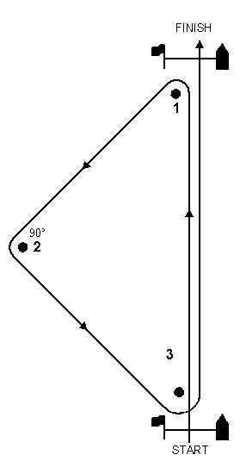
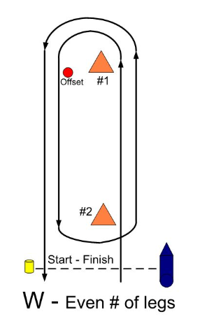
Setting the Course
Most Common:
Windward Leeward (W/L)
Once or 2X around
Uses Offset at #1
Sometimes includes gate at #2
May finish upwind or downwind
Less Common:
Triangle Windward Leeward
May include W/L after the triangle
May finish upwind or downwind

Slide 11



Starting the Race – The Starting Sequence
Minutes Before Starting Signal | Visual Signal | Sound Signal | Means
6 | Course Flag AP down | One | Attention
5 | Class Flag | One | Warning
4 | P,I,Z,IZ,U,Black | One Long | Preparatory
1 | Prep Flag Down | One | One Minute
0 | Class Flag Down | One | Start

Slide 12
Communications
How does the RC boat communicate with race competitors?
Signal Flags – are visual signals, are required by the rules.
Sounds – horns draw attention to the visual signals.
In some cases VHF Radio

Slide 13
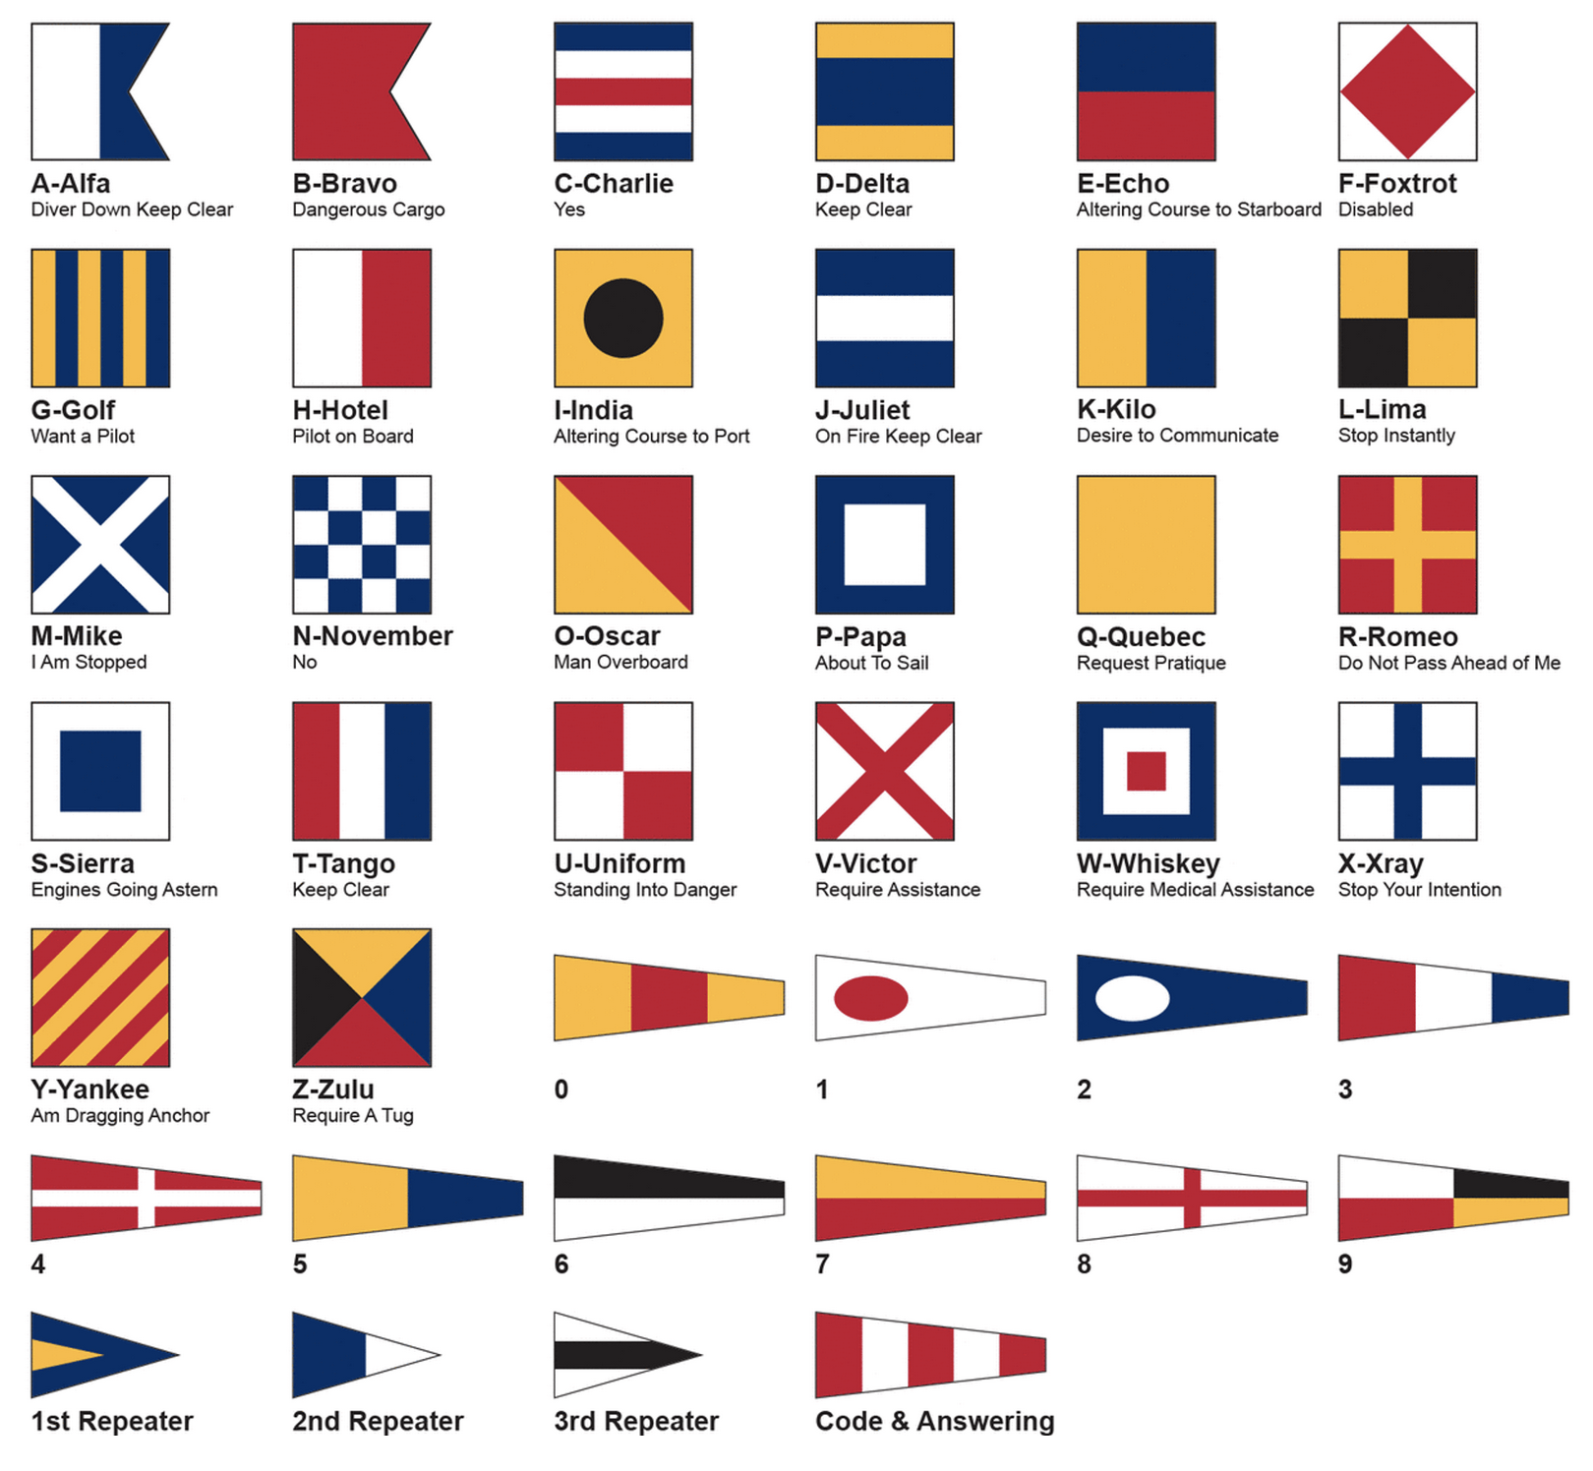
Flag Communication

Slide 14
I don’t know these flags!
Don’t Worry!
Someone with you on the LSYC Race Committee boat WILL KNOW how to use the flags! Over time you will learn too.

Slide 15


Some commonly used signal flags:
Warning Signal or Class Flag (Up at 5 Minutes to start, down at start)
Preparatory Signal (Up at 4 Minutes, down at 1 minute)
Postponement (AP)
The Principal Race Officer will help you use the flags correctly!
Individual Recall

Slide 16




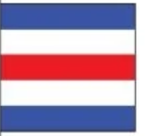
More signal flags:
General Recall (start sequence again))
I Flag Rule 30.1, If early around the End)
Z Flag (Rule 30.2, behind the line within 1 minute or around the end)
Black Flag Rule (Rule 30.4, behind the line within 1 minute or DSQ)
Moved Mark

Slide 17
Managing the Race
At LSYC we use an “Ollie Box”
  A timer and horn that automatically execute the sounds needed to start a race!
Signal boat crew raise and lower flags prior to and during the start sequence.
Signal boat crew look for racers that are “over early” for a start.
Signal boat crew record the order of finishers.

Slide 18
Protests - When competitors disagree about the rules
A protest may be filed when competitors have a rules disagreement.
A protest form must be filed within a time limit (usually shortly after racing concludes).
The protest committee will listen to both sides of the story and render a decision, which may be to disqualify one (or both!) boats from the race.
Protests are thankfully pretty rare!

Slide 19
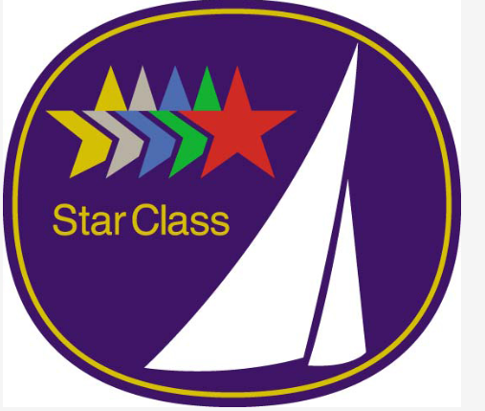
Fleets
Most often the Star Fleet will be the only fleet racing.
Other fleets of 3 or more boats may join the racing.
  420s, ILCA/Lasers or Vipers may join.
Multi-class Regattas may include up to three fleets.

Slide 20
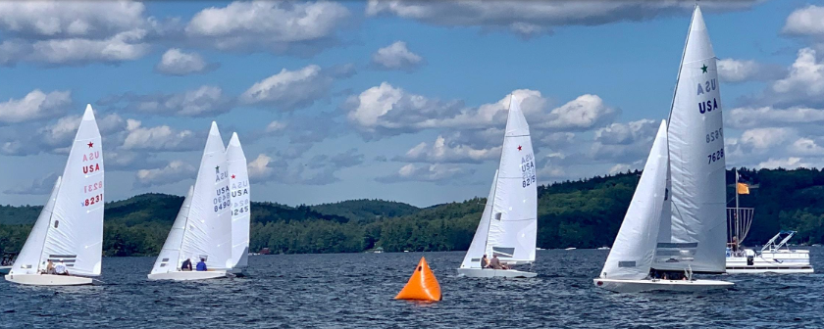
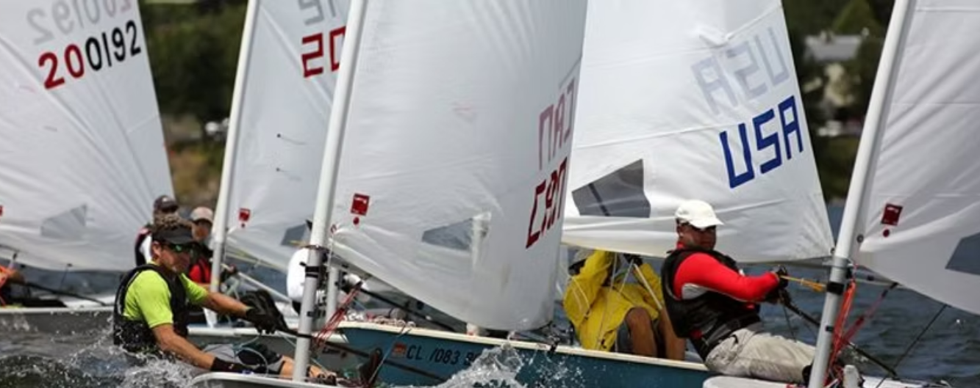

Events
Regular Fleet Racing
  Mostly Saturdays, a few Sundays (7 days total)
Special Regattas
  Sunapee Open – Stars (2 days)
  Multiclass Regatta – Flying Scots, Stars and ILCA (2 days)
Sail Sunapee Challenge
  Special Long Distance Races
  (3 days)

Slide 21
When Can I participate?
We have online sign-up!
Sign up for whatever number of shifts per season works for you and your family.
Two shifts per summer is great, more shifts is wonderful!
https://www.signupgenius.com/go/10C0E4BA4AC2DAAF4CF8-56664956-race#/

Slide 22
What should I Bring?
Pack a small bag or backpack with items such as…
Weather-appropriate clothing – Rain gear, sun hat, shoes / sandals
Sun Protection – high SPF sunscreen, sunglasses – you’re going to be outside for a while, a HAT/ visor, long sleeve top
Other Stuff – allergy or other medication, personal PFD or RC equipment. Save alcoholic beverages for after the race, please.
A great attitude – if you have fun, so will the competitors!

Slide 23

How do I learn more?
US Sailing is conducting Club Race Officer training on June 14 at LSYC!
  Join US Sailing:
    https://www.ussailing.org/membership/
  Sign up for the training:
    https://www.ussailing.org/competition/rules-officiating/resources/find-a-seminar/race-officer-seminar-calendar/
  The LSYC Race Committee will reimburse your course fee.
Or contact Duane Delfosse at racing@lsyc.net

Slide 24
Questions?
What do you want to know
that was NOT covered today?
Thank you for your anticipated help!

Slide 25
Thank You
“Volunteerism is the voice of the people
put into action. These actions shape
and mold the present into a future of which
we can all be proud.” - Helen Marie Dyer *
* Helen Marie Dyer (1895 – 1998) was an American biochemist and cancer researcher.

